Slide 1

food waste - Point 1
• Write about food waste in the U.S. Write about your own food waste .

Slide 2
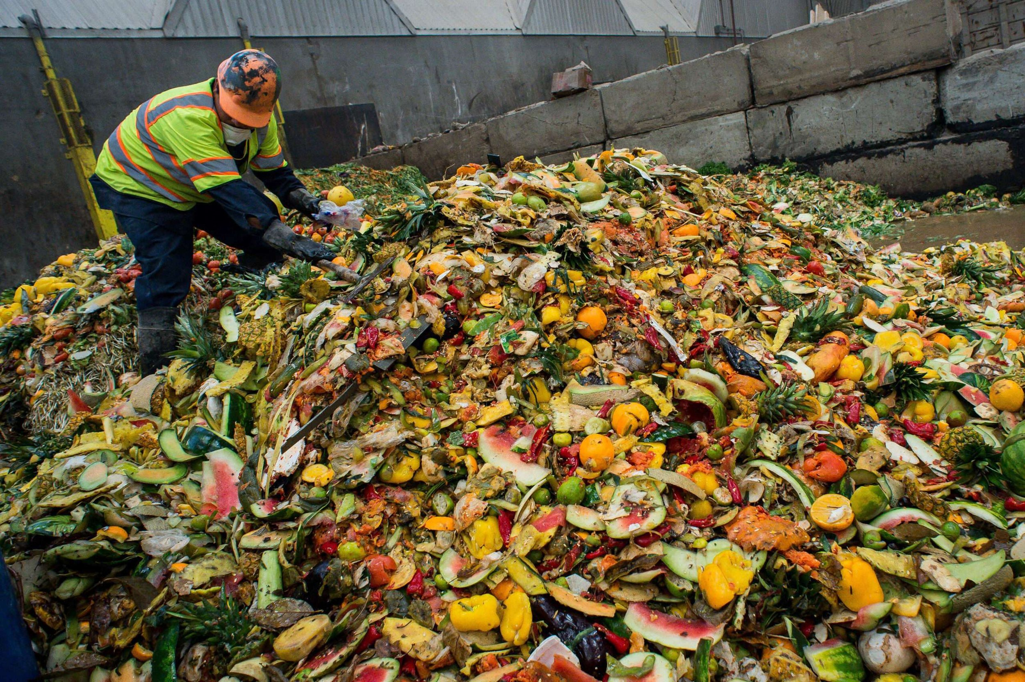
food waste - Point 2
• Share your photos of food waste with CNN iReport.com's food waste gallery .

Slide 3
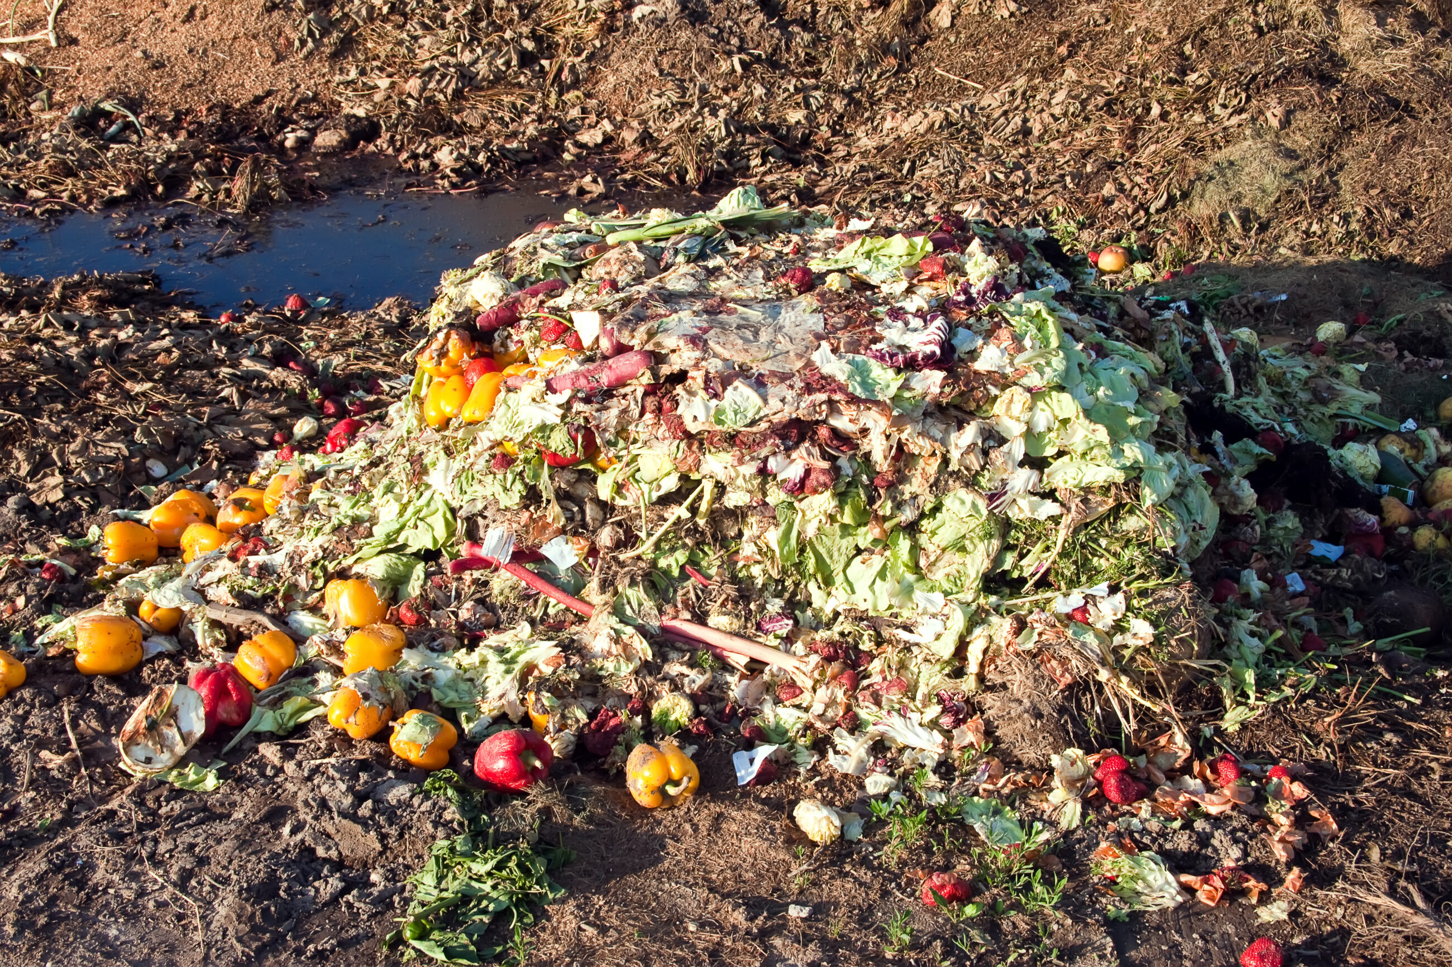
food waste - Point 3
• Visit CNN.com/FoodWaste for a new gallery of photos of waste in America .

